Slide 1
Dialogue:
Communicating Your Beliefs

Slide 2
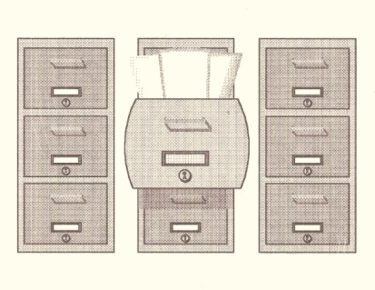
Each of us has a vast wealth of
knowledge about a variety of
subjects and communication is essential to our daily lives. Most of us appreciate being able to discuss our opinions and beliefs without an argument, criticism and/or an attack on our ego. Unfortunately, we (sometimes) bring such treatment on ourselves. Other times we are slow to recognize those certain cues that can literally zap us of our conversational energy.
Knowledge

Slide 3
This presentation will help you to identify patterns of communication that will either help or hinder your political, religious or personal communication.
* * * * * * * * * * * * *
Dialogue is:
  An exchange of personal opinions.
  A “frank and free discussion of what we believe in an atmosphere of mutual respect and trust”.
  Listening to others from the depths of his or her own convictions.
  Being responsive and attentive enough to hear and understand the meaning and message which the other is trying to express.
  Being perceptive of what words cannot carry – understanding the feelings behind the words.
  Willingness to expect that change will take place in us as well as the other person.
  An acceptance of a person in his or her own self-understanding.
  A way to tell another of your own actions based on your beliefs.

Slide 4
Dialogue is not:
A sermon
Small talk
A debate
An accusation or defense
An apology
Back slapping
An alliance against an absent party
A soft-sell approach to conversion
A rehearsal of already known facts

Slide 5
Ground Rules for Dialogue:
Believe that the other is speaking in good faith.
Have a clear understanding of your own beliefs.
Strive for a clear understanding of the belief of the other.
Accept responsibility for your part in what your group has done or is doing to foster or perpetuate division.
Face the issues which cause separation as well as those which create unity.
Recognize that all that can be done with the dialogue or discussion is to offer it up to; common sense, good orderly direction, and/or The Supreme Creator and Sustainer of the universe.

Slide 6
The following are some tips on how to enhance your communication efforts:
Make personal contact.
Use “I” statements.
Find something in common.
Give an overview of what you are attempting to communicate.
Watch for opportunities to “connect”.
Use head nods, “tell me more”, “uh uh”, etc.
When you don’t know what to say, say nothing.
Confront only to the extent that you’ve been willing to support.
If you want to change something, talk about it.
Treat each man and woman with respect, talk with them - not to them.
Notice resistance.
When in doubt, focus on feelings.

Slide 7
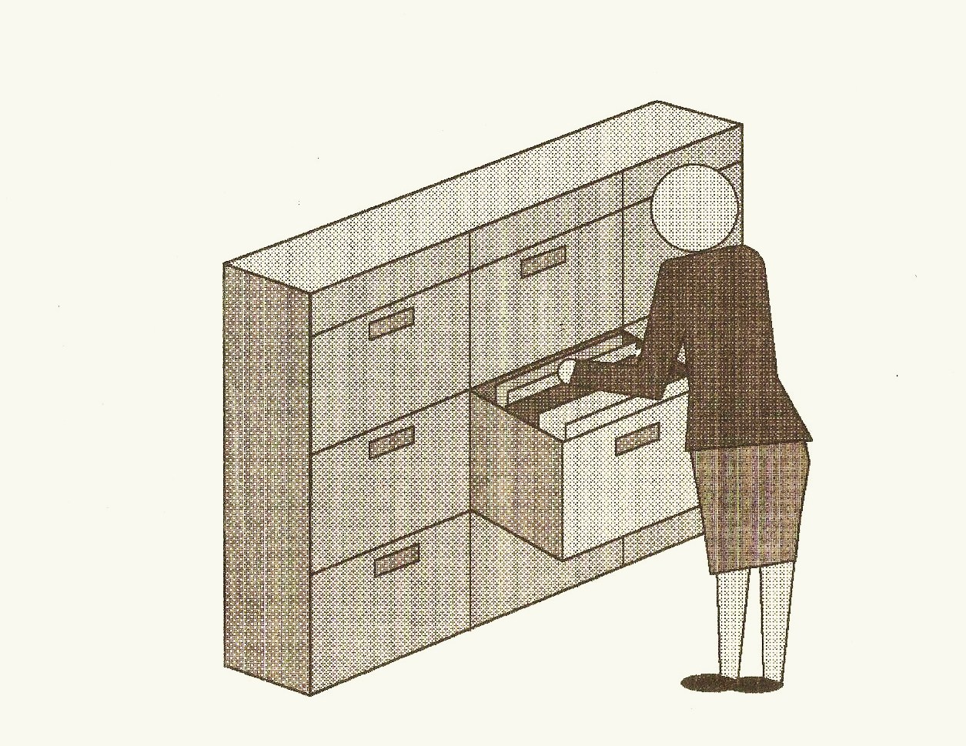
Moving toward consensus:
Workable strategies for change.

Slide 8
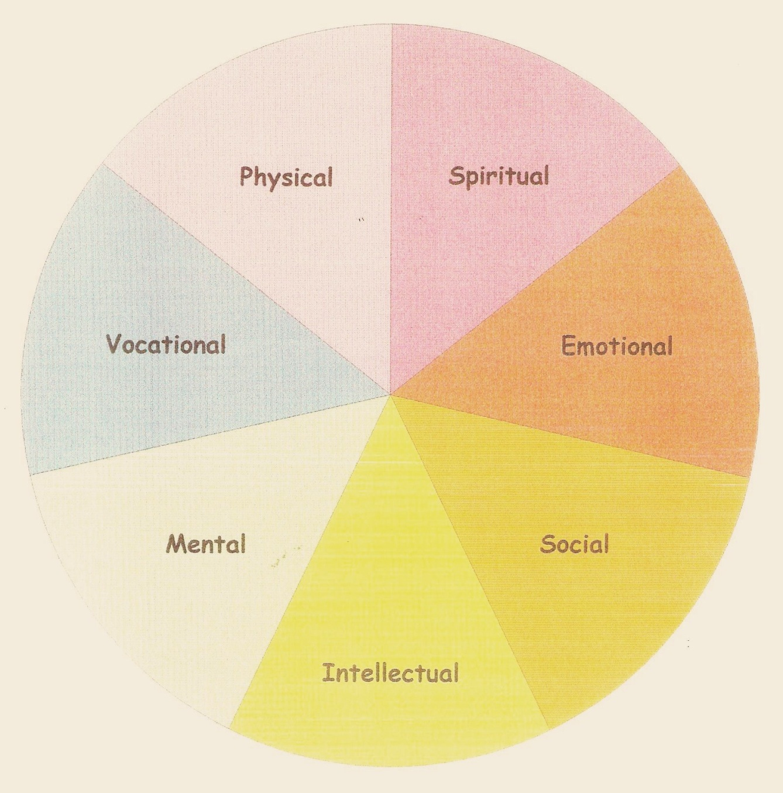
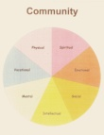
Healthy Communities are Healthy Systems.
Within these systems it is “IDEAL” that members:
Use valid (objective) data to accurately identify (I) problems in each aspect of their life within the community.
Use the information gathered to describe and dialog (D) possible solutions and outcomes.
Evaluate (E) outcomes in terms of time, money and effort.
Act (A).
Learn (L) from mistakes and begin again with the collection of more valid data, dialog, evaluation and action.

Slide 9
“Ground Rules” for collecting data:
  Positive thinking does not equal rational thinking.
  Agreement does not equal empathy.
  Make no assumption that change is simple.
  Make psychological assessments, not moral judgments.
  Do not assume that you know another’s feelings, thoughts, and behaviors.
  Make no assumption that you know how others react to their feelings, thoughts, and behaviors.

Slide 10
Know Your “Self”
Become aware of your personal issues
Ask your “self”:
  Why do I want to do this?
  What emotions am I uncomfortable with?
  What amount of progress is acceptable?
  How will I deal with the feelings other people have for me?
  How will I handle my feelings for others?
  Can I be flexible, accepting and gentle?
Am I open to supervision?
Am I open to correction?
On ethical questions will I ask for help?
Do I know where and to whom to refer people?

Slide 11
Do’s and Don’ts
DON’T:
  Give advice
  Try to solve their problems
  Ask a lot of questions
DO:
  Listen closely to what is being said
  Pay attention to non-verbals
  Keep the focus on the man or woman who is speaking
  Be concrete; listen for the substance in what’s being said
  Listen for metaphors
  Summarize for the speaker what was heard
  Accept the speaker’s correction(s) about what was heard

Slide 12
Some things to listen for:
  The complaint.
  How is their life affected by their current belief?
  How and when did they form their belief?
  How important has it been to them since then?
  How would their life be different if they chose to change their belief?
  What are their concerns, fears and/or doubts about letting go of their current beliefs?

Slide 13
Diagnosing Systems: A Matrix
(Legend: Chaotic – Cautious – Eager)
Inflexible
Flexible
Rigid
Maintenance mode
Internal desire
Decline mode
Stable
External force /
High conflict
Crisis mode
Flexible
Start-up or renewal mode
Unstable

Slide 14
Common Defense Mechanisms:
Denial of Reality
Fantasizing
Compensation
Projection
Rationalization
Repression
Reaction Formation
Displacement
Emotional Insulation
Sympathism
Regression
Intellectualizing
Like an “ostrich with its head in the sand”.
Healthy, unless taken to extremes.
Pursuit of “second-best” goals as a way of life.
Attributing one’s own unethical desires to others.
Strong resistance to any attempts to consider or explore other possible reasons for behavior.
Involuntary or unconscious attempts to keep from dealing with unpleasant feelings.
Verbalization of exaggerated attitudes opposite of the demonstrated behavior.
Lack of courage to confront the actual cause of anger.
Withdrawal into passivity or indifference to protect the self from possible future hurt.
Striving to gain sympathy in order to bolster feelings of self-worth despite personal failures.
Dependency.
Superficiality.

Slide 15
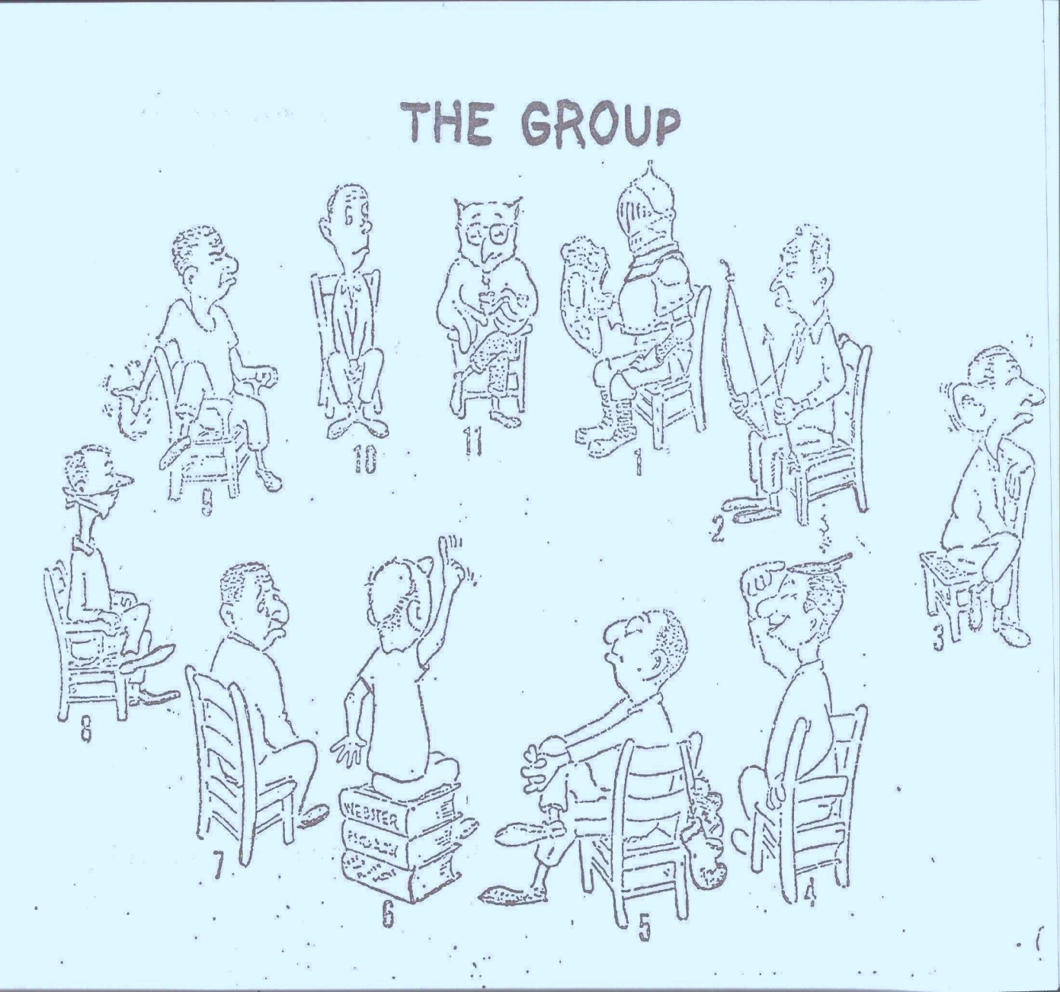
The interactions of a group are typical of those in a community.
Some tips for a group facilitator are:
“I’m interested in that idea. I wonder if anyone else has a comment on it?”
“ ___ thinks ___. Do the rest of you agree?”
“ ___ believes ___. Does anyone else have an opinion about that?”
“Can I have a show of hands of all who agree with ___?

Slide 16
How well do I listen?
Do I tune out uninteresting or “dry” subjects?
Do I criticize the speaker’s delivery?
Do I react emotionally by mentally building arguments against the speaker’s ideas or interrupt them in order to challenge or disagree?
Do I listen only for facts?
Do I try to outline everything?
Do I fake attention?
Do I tolerate or create distractions while the speaker is talking?
Do I normally avoid listening to difficult subject matter?
Do I ignore speakers who use words and gestures that I consider inappropriate?
Do I find it difficult not to daydream during long presentations?

Slide 17
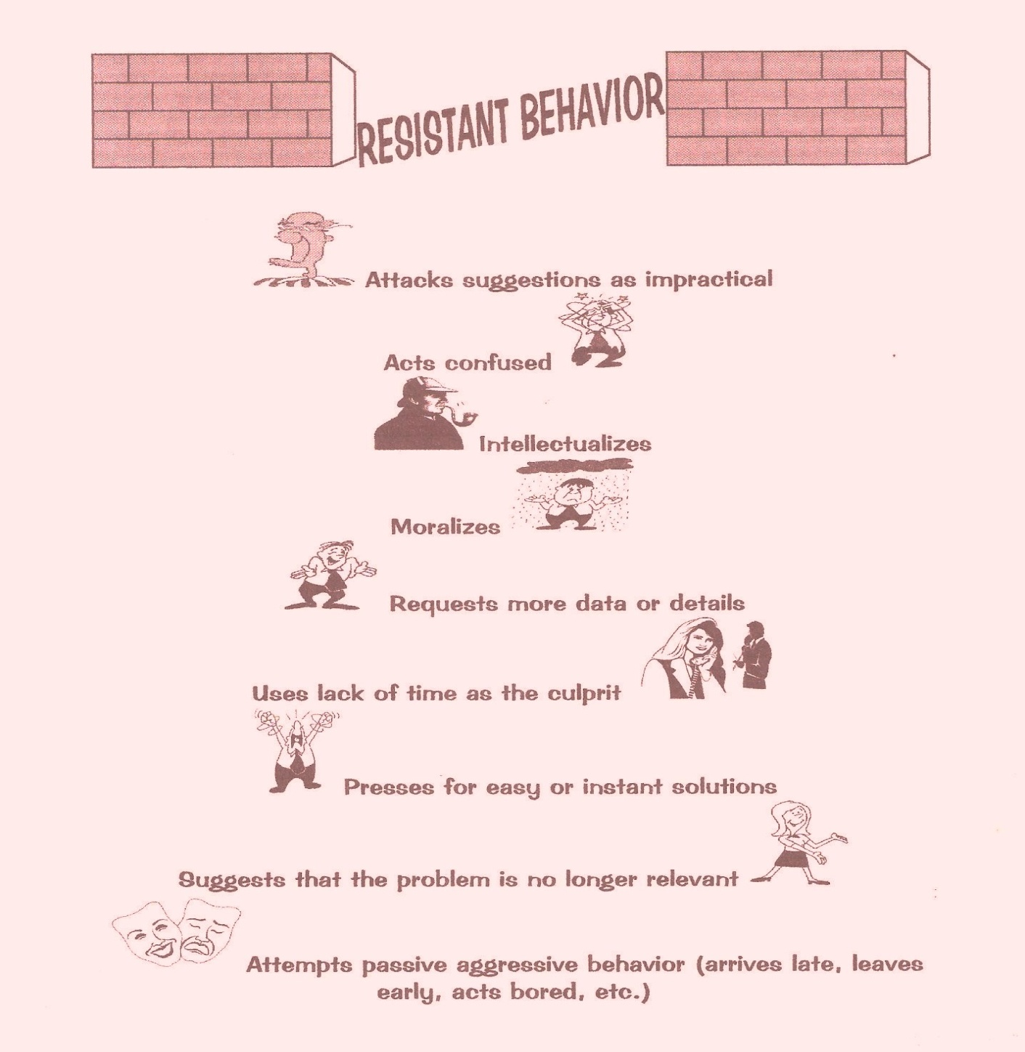
What’s the difference between Resistant and Resilient? Resilient people are said to have the following attributes:
Social Competence
  Responsive
  Flexible
  Empathic and caring
  Communicative
  Sense of humor
Autonomy
  Strong sense of independence
  Internal locus of control
  Sense of power
  Self esteem
  Self efficacy
  Self disciplined
  Impulse control
Problem-Solver
  Thinks abstractly
  Thinks reflectively
  Thinks flexibly
  Attempts alternative solutions for cognitive and social problems
Sense of Purpose and Future
  Healthy expectations
  Goal oriented
  Success oriented
  Achievement motivated
  Educational aspirations
  Persistence and hopefulness
  Optimistic
  Sense of anticipation
  Sense of compelling future
  Sense of coherence

Slide 18
Some characteristics of a healthy community:
Intellectually: The people have a “fund of knowledge”.
Physically: They care for themselves and their environment; not because of government, but because they care.
Emotionally: They experience and express their feelings appropriate to reality and cope with lives crises in constructive ways.
Socially: They communicate with and relate to others in constructive ways.
Mentally: They have the ability to learn, retain and remember information. They think and behave based on rational judgment. This includes their ability to solve problems and make decisions.
Vocationally: They follow through with a decision or a task; or to modify or change their decision when it seems appropriate. This includes the ability to do what needs to be done even when they don’t “feel” like doing it.
Spiritually: They have a sense of “I AM and I have value”. An understanding of their purpose in life which may, or may not, include a typical organized religious belief.
Total “Wellness” includes an ability to function both independently and interdependently, deal with crises constructively and do what needs to be done even under emotionally painful circumstances.

Slide 19
Best Wishes
Presentation compiled from Professional Journals, etc.
by
Veronica “Niki” Hannevig

